Slide 1
Dealing with conflict- winning strategies

Slide 2
Remember that relational conflict is expected
Any two rational people will have differences of opinion
How you deal with those differences will determine the success or failure of the relationship
Notes:
Just knowing that your relationship isn’t supposed to be continually peaceful is liberating.
Expect that there will be times of conflict and use them to strengthen your connection.
Identify ways you fundamentally look at life differently.
Anticipate that those areas could be sources of stress. Talk them through.
Think of a person in your life. How are you fundamentally different?
How could that be problematic in regards to:
Time management
Money – income and spending
Respectful behavior – cultural expectations
Work ethic – feel that work load is appropriate
Ambition – what you want for future and what you sacrifice to get it
Family – chore allotment
Traditions – religious values, social interactions, family duty

Slide 3
Step 1-Gratitude
“You always get more of what you appreciate in others.”
Dr. Jennifer Finlayson-Fife
Notes:
EMPOWERING YOUR LOVED ONES through GRATITUDE
Appreciate anything they do or have ever done in the past that is close to what you are after.
YOU ALWAYS GET MORE OF WHAT YOU APPRECIATE.
We all want to be valued, appreciated. When we're getting that, we are more motivated to give.
Why might it be difficult to say what we appreciate?
Walled off? (What are we trying to protect?)
Vulnerability?
Exposure?
Recognition of our dependency? Oftentimes people who do not express gratitude are actually afraid of the other person being TOO important to them. Trying to diminish their importance, by diminishing the other person (criticism or withholding)
Pride?(safer, less vulnerable positions).

Slide 4
You Determine Your Happiness
It’s not so much a matter of positive thinking as clear thinking. An extra 10-20 seconds of focusing on gratitude can change it from a positive thought to installing it into our neural structure. It becomes who we are.
Dr. Rick Hanson, a neuropsychologist, a member of U.C. Berkeley's Greater Good Science Center's advisory board, and author of the book Hardwiring Happiness: The New Brain Science of Contentment, Calm, and Confidence
Notes:
According to Dr. Rick Hanson, a neuropsychologist, a member of U.C. Berkeley's Greater Good Science Center's advisory board, and author of the bookHardwiring Happiness: The New Brain Science of Contentment, Calm, and Confidence, our brains are naturally wired to focus on the negative, which can make us feel stressed and unhappy even though there are a lot of positive things in our lives. True, life can be hard, and legitimately terrible sometimes. Hanson’s book (a sort of self-help manual grounded in research on learning and brain structure) doesn’t suggest that we avoid dwelling on negative experiences altogether—that would be impossible. Instead, he advocates training our brains to appreciate positive experiences when we do have them, by taking the time to focus on them and install them in the brain.
There’s a classic saying: "Neurons that fire together, wire together." What that means is that repeated patterns of mental activity build neural structure. This process occurs through a lot of different mechanisms, including sensitizing existing synapses and building new synapses, as well as bringing more blood to busy regions. The problem is that the brain is very good at building brain structure from negative experiences. We learn immediately from pain—you know, “once burned, twice shy.” Unfortunately, the brain is relatively poor at turning positive experiences into emotional learning neural structure.
In terms of our need for satisfaction, of experiences of gratitude, gladness, accomplishment, feeling successful, feeling that there’s a fullness in your life rather than an emptiness or a scarcity. As people increasingly install those traits, they’re going to be more able to deal with issues such as loss, or being thwarted, or being disappointed.

Slide 5
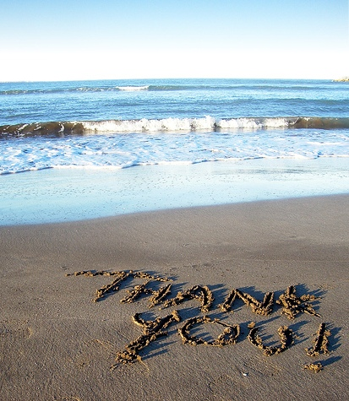
Sincere gratitude is antithetical to entitlement
Gratitude is the opposite of “You owe me…”
Notes:
Sincere GRATITUDE is antithetical to entitlement. It pushes us to acknowledge the fallacy of the belief that “You're supposed to make me happy”---”you owe me happiness” .
Most of us live in some level of resentment towards our spouse, not for egregious misdeeds, but because they didn't deliver on a promise that they never agreed to in the first place
The promise to make us happy, to take away our pain, to make us feel desirable at all times, to calm our fears, to give us self-confidence, etc.
When they don't give us all of this, we can resent.
Gratitude is antithetical to this stance. It is for us to acknowledge the gifts given to us that we are not OWED, but that we have been given. The acknowledgment of which gives strength to the relationship (Dr. John Gottman’s work)
Sincere gratitude forces us to recognize what our spouse does for us as GIFTS, Gifts to which we are not entitled, but that BLESS OUR LIVES.
Gratitude keeps us out of Pride
AND Increases our chances of getting more of what enriches our lives.

Slide 6
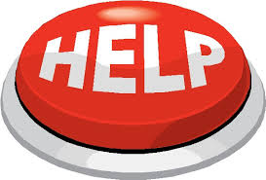
Step 2-Making Requests
Not as easy as it sounds…
Why?

Slide 7
Why we don’t ask for what we want
Less vulnerable- Don't have to face disappointment
Don't actually know what we want
Don’t have to figure out a solution
Risk shaking up the relationship
Notes:
Seems pretty intuitive that REQUESTS for what we actually want would be much more effective in giving us what we want from our relationship, than COMPLAINTS about what we didn't get after the fact. So then why is complaining so compelling? Why do we spend so much time complaining at our family?
Less vulnerable. Don't have to face disappointment.
(Since you're not actually asking for something in complaint, can't be let down)
Solution is rarely on your mind while complaining (Wanting more to construct yourself as a victim. And that they hold the key to your happiness if they would just get it together and give it to you).
(Control, unbridled self-expression, and punishment are very much on your mind).
You want them to be responsible for your happiness, without you having to OWN that you need something or WANT something.
Wanting is an act-of self-definition and we often do not want to define ourselves as well as create the possibility of being disappointed.
You Risk shaking up your relationship if you are going to ask for something and mean it.
Rather than risk we expect our partners to READ MY MIND

Slide 8
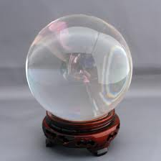
Often, we expect our loved ones to read our minds
Notes:
Why is this such a negative approach?

Slide 9
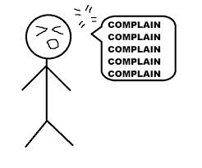
YOU HAVE NO RIGHT TO COMPLAIN ABOUT NOT GETTING WHAT YOU'VE NEVER ASKED FOR.
Notes:
Complaining says Blah,Blah,Blah, I’m not happy,
you are the reason I’m not happy
you have to fix it, or I will stay unhappy
There is no constructive information.
Instead say I feel ____________________
Because of __________________________
Will you do_________________________

Slide 10
Make a reasonable, doable request
Don’t demand perfection!
What gets you closer to your goal?
What would your loved one consider reasonable?
Can they actually do what you ask?
Notes:
Will you commit to discussing any purchase above $50 with me before buying?
Will you call me if you are going to be late for dinner?
Will you fold your clean clothes and put them in the drawers?
Will you tend the kids one evening a week so I can have some time off?
Will you speak to me in kind terms without disrespect or swearing?
Not
Will you stop being a jerk?
Will you always be nice?
Will you promise to keep your room clean?
Will you never get mad at me?

Slide 11
So, what happens when you make a reasonable doable request, and they say “No”?
Notes:
Here is the hardest part of dealing with relational conflict
You have to be completely clear that you cannot control other people.
However, you have to make a judgement call for safety. Certainly, you will not let a toddler choose whether or not to play in the street. Likewise, a teenager, even though in an adult body, does not have an adult brain and will need boundaries. Like my sister-in-Law says, “After I tell them twice, I systematically remove their sources of pleasure.”
Admittedly, this next step requires unheralded patience and strength.
Most people can get through this process once or twice, but when they meet with opposition, they usually resort to complaining and losing strategies. It is habit and it feels less vulnerable. But THEY ARE STILL LOSING STRATEGIES!
Real strength comes from not having to use coercion or manipulation. Real strength comes from love, self control, and knowing that you are as good as, but NOT better than anyone else.

Slide 12
Step 3-Self Soothing managing your own anxiety
Stop talking and focus on your breathing
Lower your volume
Unclench your teeth
Speak with less intensity
Look for other person’s emotion
Don't make things worse
Stop telling yourself negative things
Schedule time to reconnect after a time out
Use your time apart effectively
Notes:
So, what do we do when we are in that tough spot?
Some sort of self-protective move (FIGHT ,Freeze FLIGHT , FIX)
Losing Strategies (List of common self-protective but relationally damaging strategies)
Tolerate Solitude (hold our autonomy) in our relationships
a. Paradox of relational esteem is that it requires our ability to sit with our unmet longings without punishing our spouse or others.
Our capacity to stay close to people rests on our ability to tolerate our unmet longings (without entitlement), recognizing that they are a flawed human being, not a caretaker
Staying loving and respectful to someone who is disappointing us is Christ-like behavior. It is one of the most difficult relationship skills we can learn. It requires us to maintain our own separate value, and see the value of the relationship even though it is less than perfect.

Slide 13
10 Healthy Ways to Self-Soothe
1. Meditate/Pray
2. Exercise
3. Bath/Massage
4. Focused Breathing
5. Listening/Playing music
6. Journaling
7. Organize/Clean
8. Play a game
9. Read
10. Find something funny
Notes:
What ways have you found that help you to calm down and gain perspective?
Humor -
Cake wrecks
Mystery Science Theater 3000
Engrish
Epic Fail
There, I fixed it
Awkward family photos
Books:
Eats Shoots and Leaves
Patrick McMannus
Terry Pratchet-Disc World

Slide 14
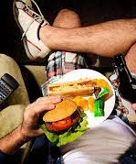
Self soothing is not:
self indulgence
complaining to friend
shopping
overeating
over sleeping
mindless TV, computer, gaming
drugs and alcohol
Notes:
Often, we resort to these behaviors to calm ourselves when we are distressed for not getting what we want. These behaviors may distract us, but they do nothing to actually soothe our unhappiness. They may make the situation worse.
Any virtue carried to an extreme becomes a vice.

Slide 15
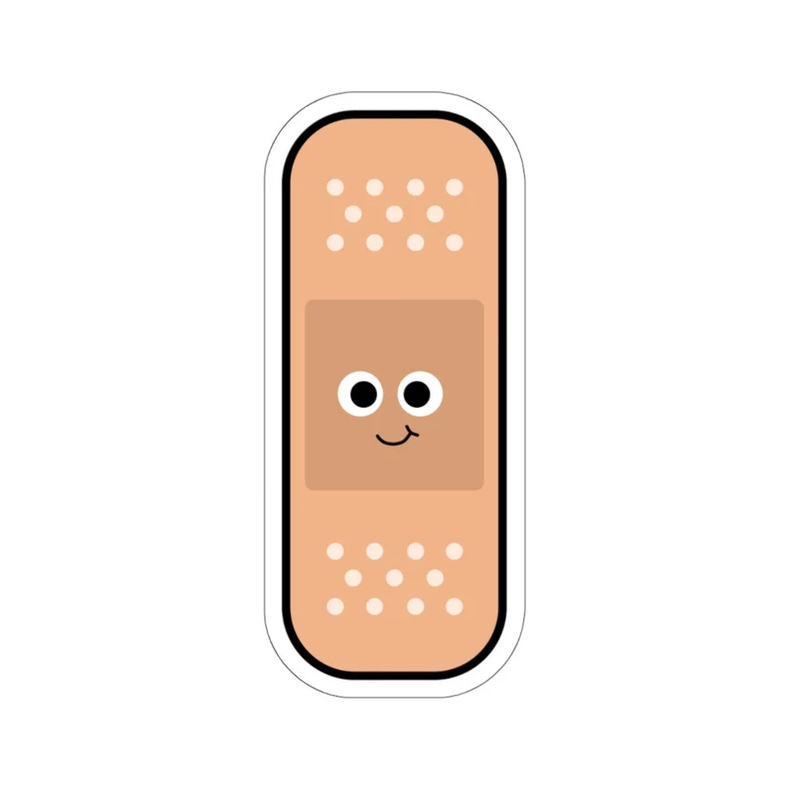
Step 4-attempt a repair
The soft Startup
Nurture your fondness and admiration.
Think of something positive. Say it.
Find something you are grateful for in your relationship. Say it.
Notes:
Sometimes you need a space to gather your thoughts. That’s fine but you can’t just walk away. That is the losing strategy of withdrawal.
You need to respectfully say I need to calm down but I promise I will return to work this out. Can you give me 10 minutes? Half an hour? After the kids are in bed?
You must reconnect to avoid leaving the situation hanging.

Slide 16
Repair checklist Dr. John Gottman
I appreciate
I know this isn’t your fault
Let me see if I understand
I admire you for…
Thank you for listening
I feel
I’m getting scared
That hurt my feelings
I’m sad that…
This worries me
I’m frustrated that…
I need to calm down
I need things to be calmer right now
This is important to me, please listen
Can we take a break?
Can I take that back?
Stop Action!
I might be wrong here
Please, let’s stop for a while
Give me a moment, I’ll be right back
We are getting off track
Sorry
My reactions were too extreme
I really blew that one
Sorry, let me try that one again
Let me start again in a softer way
My part of the problem is…
Get to Yes
You are starting to convince me
I agree with part of what you are saying
I’ve never thought of things that way
Let’s compromise here
Notes:
All relationships are in an endless dance of harmony, disharmony, and repair.
What is the “Crunch” in a relationship?
Place where we are achingly aware of the discrepancy between what we want and what we are getting.
Stuck in the knowledge without love phase. (disharmony)
Don't know how to move out of it.
Humor as a repair attempt- If it works, it works big, but it is a high-risk strategy. Stanford humor Study. Apparently, men and women absorb humor differently. Men anticipate humor and positively assume it will be an enjoyable experience. Their brain-chemical (dopamine) reward is mildly pleasurable. Women though are far more skeptical. Their doubt is high that something will be funny, but when it is, they get a large chemical payout in dopamine. So, a consistently funny person or activity is very attractive to women. However, when a joke turns out not to be funny, their negative feelings are much stronger than for men.
Result could be…
You’re making fun of me?
This is no laughing matter!
Oh, You think this is funny!?

Slide 17
Winning Strategies
Gratitude
Reasonable requests
Self Soothing
Repair attempts

